Slide 1
Supply Chain Management of Agriculture in Nepal Agricultural Development for Socio-Economic Transformation in Nepal Nepal Agricultural Economics Society (NAES)
Prof . Achyut Wagle, PhD
Economist
Kathmandu University

Slide 2
Agricutural Imports
Of total imports of Rs 839 billion, about one-third of imports is agricutural products.
Staples/Cereals 25% (Rice 16%, Maize 5%)
Edible oil 26%
Vegetables 12%
Fruits 10%
Fish/Meat/Poultry 7%
Dairy 4%
Processed products 8%
(source: Department of Customs and authors calculation)

Slide 3
SN | Trade Indicators | FY 2077/78 (5 Months) | FY 2078/79 (5 Months) | Change (%)
1 | Imports (Rs.in `000) | 525,498,142 | 838,408,242 | 59.55
2 | Exports (Rs.in `000) | 50,055,608 | 102,920,572 | 105.61
3 | Trade Deficit (Rs.in `000) | 475,442,534 | 735,487,670 | 54.70
4 | Total Foreign Trade (Rs.in `000) | 575,553,751 | 941,328,814 | 63.55
5 | Imports/Exports Ratio | 10.50 | 8.15 | -22.40
6 | Exports Share to Total Trade (%) | 8.70 | 10.93 | 25.72
7 | Imports Share to Total Trade (%) | 91.30 | 89.07 | -2.45

Slide 4
Agricultural Supply Chain
Agricultural Supply Chain : A wholistic view
Agriculture supply chain begin with acquiring modern inputs, sowing and cultivation of agricultural produce, post harvest management, storage and transportation, food processing and distribution, and marketing agricultural produce.
Post-harvest supply Chain
Agribusiness Supply Chain
Agricultural value Chain
4. Product Specific Supply Chain
Sub-supply chains: Staples, Poultry, Meat and fish products, Vegetables, Fruits, Dairy, Pulses, Industrial crops/Related products, Forestry related products

Slide 5
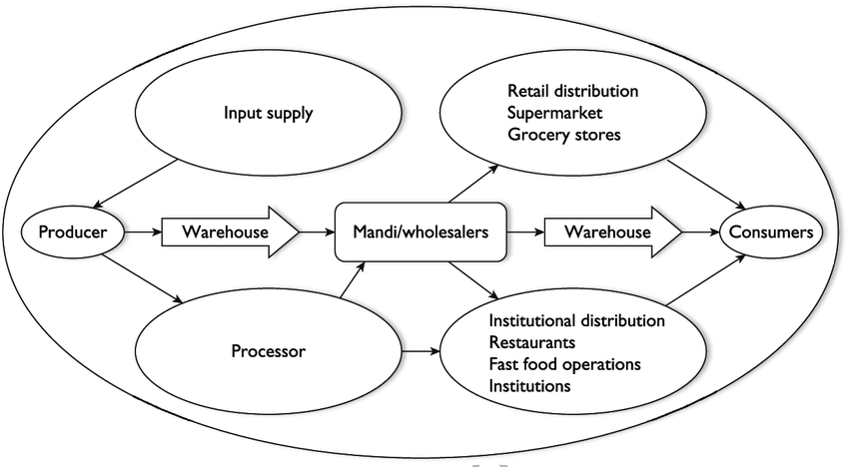

Slide 6
Agricultural Supply Chain
Supply Chain Management is a process of integrating various activities associated with efficient flow and transformation of produce from raw material to the end users with all-round information flow to improve supply chain relationships in achieving sustainable competitive advantage.
Agriculture can realise its full potential by applying the principles of supply chain management by strengthening collaboration between various stakeholders, non-exploitative vertical and horizontal integration, market reforms, precision farming, contract farming, demand-led diversification, and the extensive and intensive use of information technology for real-time communication across the chain (Balakrishnan, 2006).

Slide 7
Issues in Nepal’s ASC
Nepal’s ASC managemnt is highly fragmented across the government (s), cooperatives, corporate houses and MNCs.
Availability of inputs-seeds, fertilizers, pesticides
Cropping system
Production- scales, supply, demand (adequacy, pattern, seasonality)
Processing, branding and value addition
Phyto-sanitation,/pesticides/quality control issues
Distribution and Market Access/layers of intermediries/ middlemen/ Supply adequacy
Price fairness-producers, traders and consumers/MSP system has largely failed in paddy, sugercane etc.

Slide 8
Structural Issues
Scale and diversification rooted in subsistence, size of land-holding and linked to Information, education and mechanization.
Support service mechanisms, lack of coordination among the sub-systems
Infrastructure-Production, processing, transportaion, storage and product validation.
Land-use planning, irrigation, underuse of the cultivable land, agricultural manpower
Limping and herding.
Trained and skilled manpower development for agriculture and role of academic institutions

Slide 9
Policy Issues
Investment: public, private, FDI, Cooperatives?
Agricutural Act
Agricultural Supply-chain policy
Agricultural Value chain policy
Food Supply chain policy liking to food security
Monetary Policy: commercial banks to extend at least 15 percent of their total loans to the agriculture, energy, micro, cottage, and medium scale industries.
But, actual implmetation of such provisions have been unimpressive/problematic

Slide 10
Challenges
FITTA 2019: Schedule (Relating to sub-section (2) of Section 3) Industries or Businesses Restricted for Foreign Investment
1. Poultry farming, fisheries, bee-keeping, fruits, vegetables, oil seeds, pulse seeds, milk industry and other sectors of primary agro-production,
2. Cottage and small industries.

Slide 11
Challenges (eg on Paddy prodn)
Growth rate of paddy production is lower than population growth
Lack of manpower, lack of irrigation, storage and market infrastructure
Although the area covered by advanced varieties is about 90 percent, lack of quality seeds and farmers' preference to old varieties over new and high yielding varieties.
Lack of practices to change the developed seeds and variety of species
Increase in use of fine and fragrant rice and lack of diversification in use of food crops
Indigenous paddy cannot compete in quality and price of imported paddy. (Source: Dept. of Agriculture)

Slide 12
Way Forward
Identification of problematic nodes in the Supply/Value Chains
Use of data/evidences in planning and investment and their use in policy-formulation
Farm-land policy, to use the cultivable land
Investment policy review to further open it up
Market exploration-domestic and international
Alloying the crop/price failure risks and sense of farmers insecurity
Contingency fund for fertilizer purchase a year in advance
Proritizing production, storage and market access in accordance with the changing consumption patterns.
Political will and heart on the issue.

